Slide 1

Санкт-Петербург
2017
ГБОУ СОШ №619
Калининского района
«Многогранная Россия»
Реалии в английском языке как средство выражения национально-культурных особенностей
Перекина Елена
8Б класс
Научный руководитель: Шмелева И.А.

Slide 2
Цель исследования – изучение реалий английской культуры и способов их перевода.
Предмет исследования: роль культурных реалий английского языка в понимании национального и исторического своеобразия народов Великобритании.
Выдвинутая цель исследования определила следующие задачи:
1. Изучить понятие «реалии» как языковой и культурной особенности страны и народа;
2. Проанализировать способы перевода реалий на русский язык;
3. Рассмотреть уклад жизни и воспитания британцев для представления термина реалий;
4. Разработать анкету «Facts about Britain» («Факты о Британии»);
5. Провести анкетирование среди учащихся 11 класса, чтобы определить насколько близко ученики ознакомлены с культурным содержанием изучаемого языка;
6. Разработать брошюру для уроков страноведения, содержащую наиболее встречающиеся и употребляемые реалии страны изучаемого языка.

Slide 3
Please, queue here!
Keep calm and carry on!
Sorry doesn’t seem the hardest word.
You can become rich, but you can not become a gentleman.
I have got a sweet tooth!
Keep themselves to themselves!
Could you give me…?
Can you name…?
Could you tell me/help me?
Here you can see the results of our research:
подбор необходимых фраз и разговорных клише для запроса информации
названия блюд страны изучаемого языка
определение смысла идиом и фразеологических выражений
название стран, входящих в состав Великобритании, их символов и географических особенностей
определение термина «реалии» по предметам и занятиям, характерным для Великобритании

Slide 4
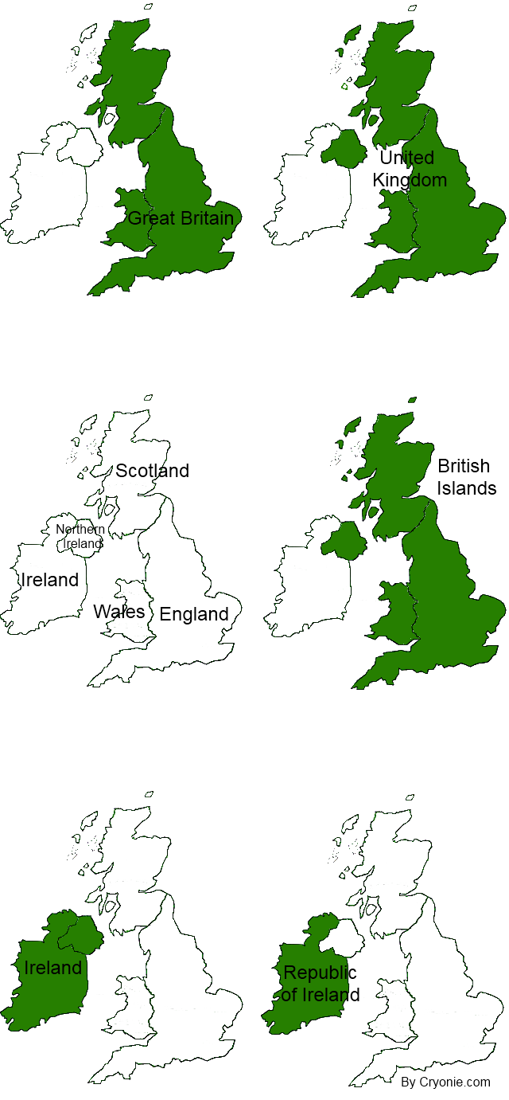
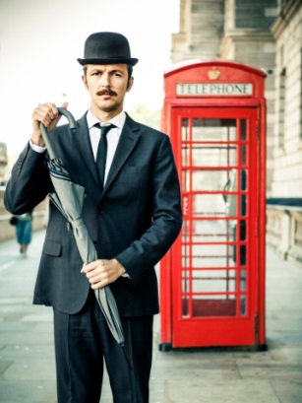
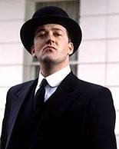
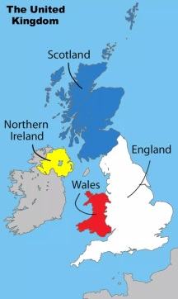
To be British
Britain – the right names
Britain – or Great Britain (GB) – is the name for England, Wales and Scotland. The British Isles is the name for England, Scotland, Wales, both parts of Ireland, the Isle of Man and the Channel Islands. The United Kingdom (UK) is England, Scotland, Wales and Northern Ireland. The British Government is the government of the UK.
People who live in Britain are called British. Many people think that ‘English’ is the same as ‘British’. But England is only one of the four nations in the UK. The Scots, Welsh and Northern Irish are British too. They sometimes get angry when they are called ‘English’.
keep themselves to themselves – вести замкнутый образ жизни
stiff upper lip - "плотно сжатые губы"; английский характер (символ выдержки и упорства)
Британский вариант | Американский вариант | Перевод
Pavement | Sidewalk | мостовая, тротуар
Lift | Elevator | лифт
Lorry | Truck | грузовик
Rubbish | Garbage/Trash | мусор
Holiday | Vacation | каникулы, отпуск

Slide 5
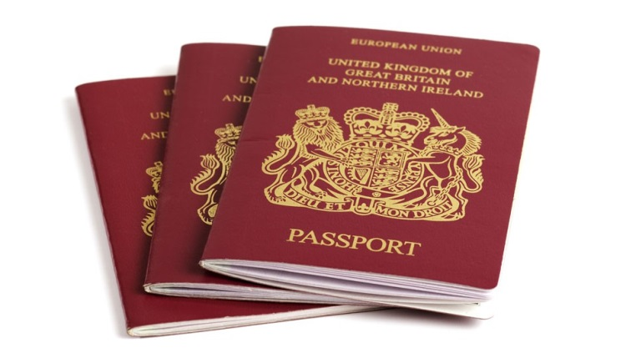
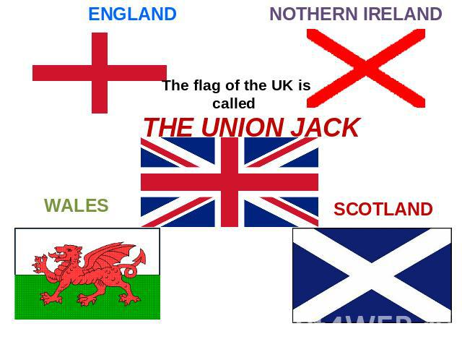
Union Jack
Britain’s flag is called the ‘Union Jack’. It’s really three flags on top of each other and it represents England, Scotland and Ireland. Of course, each country in Britain has its own flag. It is worth remembering that the Union Jack is more popular in England than in Ireland, Scotland and Wales. The reason is that the Welsh, Scottish and Irish do not like being reminded of the time when they lost their independence to England.
Крест покровителя Англии святого Георга (St. George)
Крест покровителя Шотландии святого Эндрю (St. Andrew)
Крест покровителя Ирландии святого Патрика (St. Patrick)
Names
A person’s name sometimes tells us where their family first came from. ‘Mac’ or ‘Mc’ in a surname (for example, McDonald) is always either Scottish or Irish. ‘O’ in a surname (for example, O’Brien) is always Irish. Other surnames like Morgan and Jones, are Welsh.

Slide 6
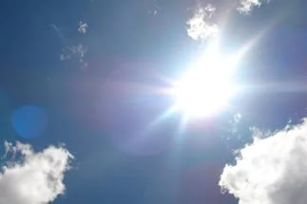
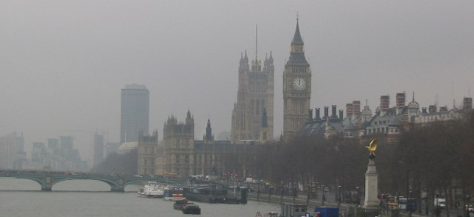
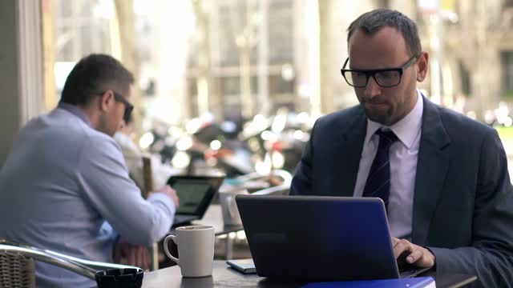
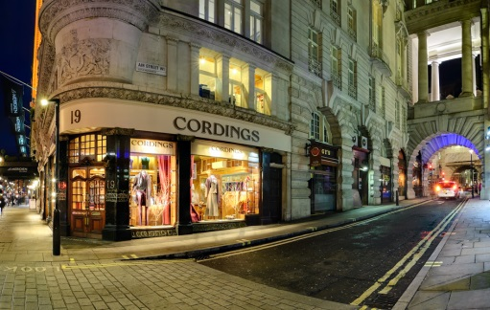
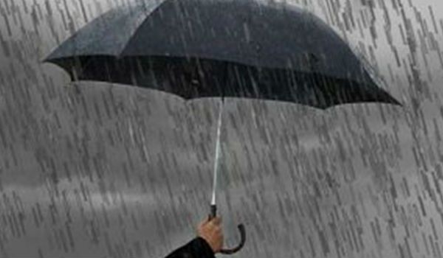
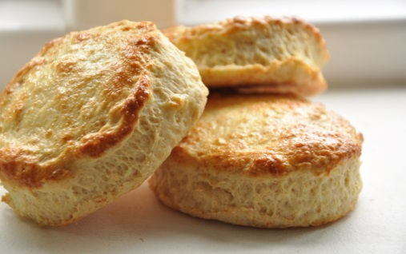
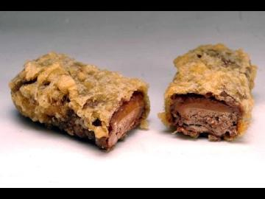
The British character
There are some cultural characteristics.
For example, it is true that British people often talk about the weather, especially if they don’t know each other very well.
Nowhere else in Britain a cup of tea plays such an important role as it does in England. Tea is not just a drink, it’s a whole English institution. In joy and trouble, a good cup of tea is what makes English people cope with whatever life throws at them.
Another example is some Scottish eating habits. One of them is deep-fried Mars-bars. Do you know how they are made? It’s very simple – you take a Mars-bar, dip it in batter and then fry it in hot oil. Do you know any other nations that do that? I think not!
If you are told to 'help yourself' to something, it doesn't mean that your host is rude-he or she is just showing that you are completely accepted and just like ‘one of the family'
(один из нас;
чувствуй себя как дома)
scones - небольшого размера британский хлеб быстрого приготовления, является основным компонентом девонширского чая со сливками
deep-dried Mars-bars – поджаренные шоколадные батончики Марс

Slide 7
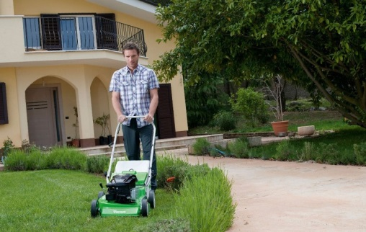
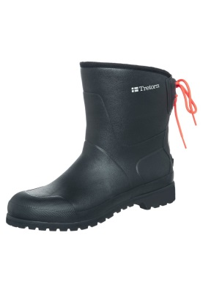
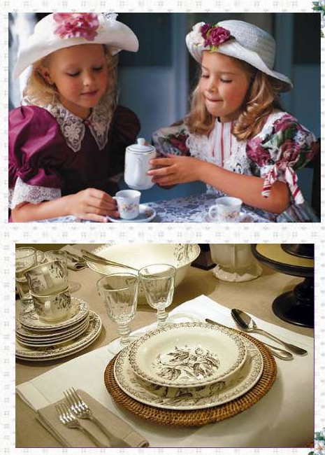
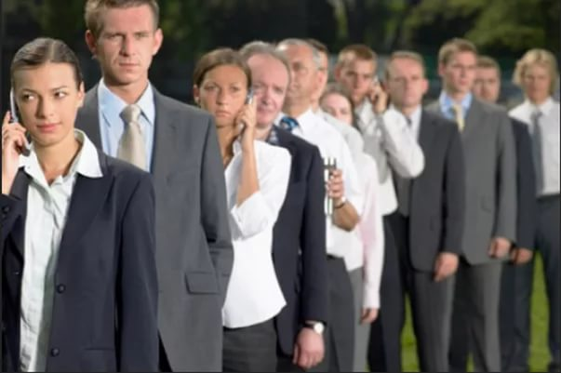
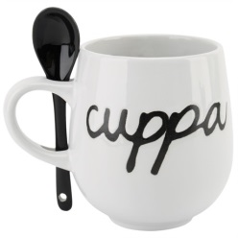
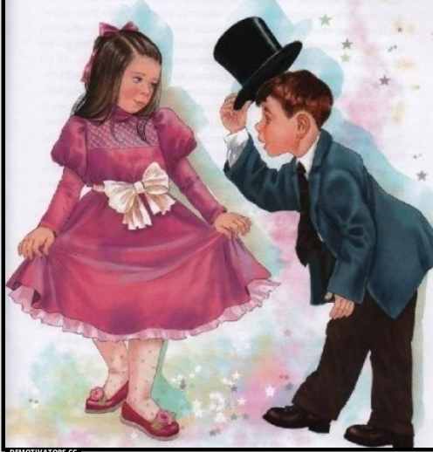
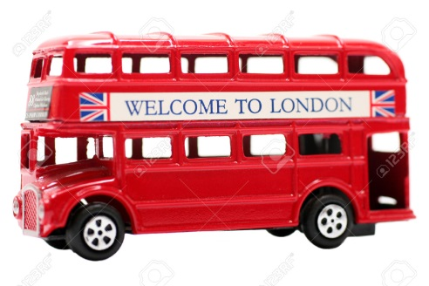
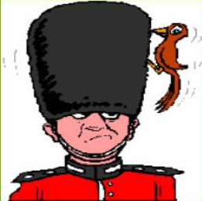
How the British relax or Gardening
Like everybody else, British people like doing things outside work.
Gardening is a well-known favourite. As the British weather un Britain is relatively mild, British people manage to do gardening almost all the year around. Every Sunday morning (except for winter) they come out to mow their lawns.
(садоводство, стрижка лужайки перед домом ради удовольствия, уход за садом)
Walking is also popular. You need a good pair of walking boots or 'wellies' to enjoy your walk. Walking as a leisure activity has a long tradition in England.
(прорезиненная обувь для прогулок)
Politeness - вежливость
The cuppa (an affectionate name for a cup of tea) – чашечка чая
Queuing - Нельзя стать первым без очереди!
Double-deckers – двухэтажный автобус
Good manners – хорошие манеры
Sense of humour – чувство юмора

Slide 8
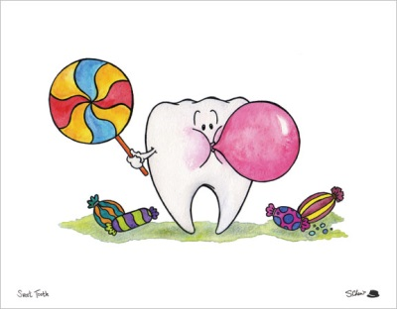
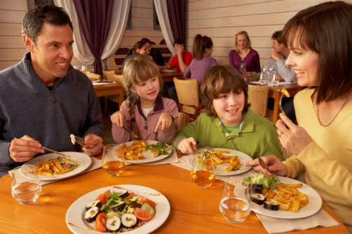
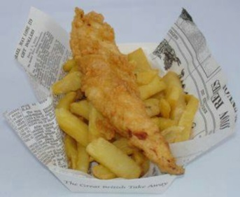
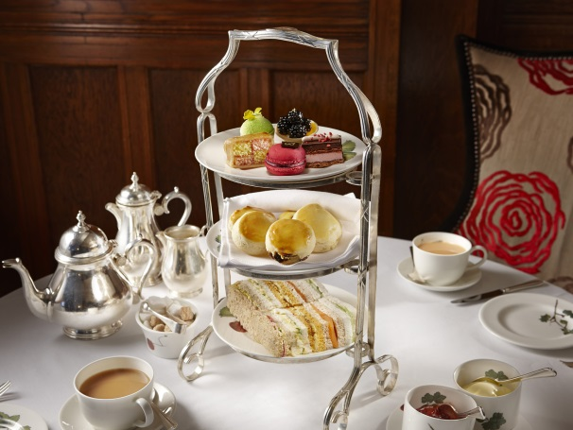
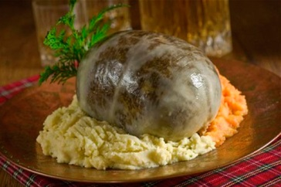
The British and food
The British have a ‘sweet tooth’. They love cakes, chocolates and sweets.
Twenty years ago, British people usually ate at home. They only went out for a meal at special times, like for somebody’s birthday. But today many people eat out at least once a week.
On the 25th of January many Scottish people go to ‘Burns’ suppers’. At these parties they read from the work of their national poet Robert Burns, wear kilts, sing their traditional songs, dance traditional dances and eat haggis. Haggis is Scotland’s best known traditional dish made from lamb’s lungs, liver and heart and mixed with onions and spices. It’s traditionally packed in a sheep’s stomach. It probably doesn’t sound appetising, but most people who were brave enough to try it say that it’s very tasty!
Fish and chips is the classic English take-away food. It is usually bought ready cooked at special shops – fish and chips shops (or ‘chippies’ as they are sometimes called) – and taken away wrapped in paper to be eaten at home or outside.
Afternoon tea is a small meal, not drink. Now most ordinary British families do not have time for afternoon tea at home, but in the past it was a tradition. But the British working population didn’t have afternoon tea. They had a meal at about midday, and a meal after work, between five and seven o’clock. This meal was called ‘high tea’, or just ‘tea’. Some families in Scotland and north of England still have ‘high tea’ and some restaurants in these areas offer it too.
sweet tooth – сладкоежка, сластёна
eating out – прием пищи вне дома
fish and chips – рыба и жареный картофель
haggis – готовится из отваренных в бараньем желудке потрохов (легких, печенки, сердца) барана или овцы
afternoon tea –
не просто чаепитие в дневное время, а небольшой прием пищи
high tea –
прием пищи в вечернее время с 5 до 7 часов; также предлагается в ресторанах

Slide 9
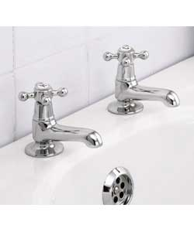
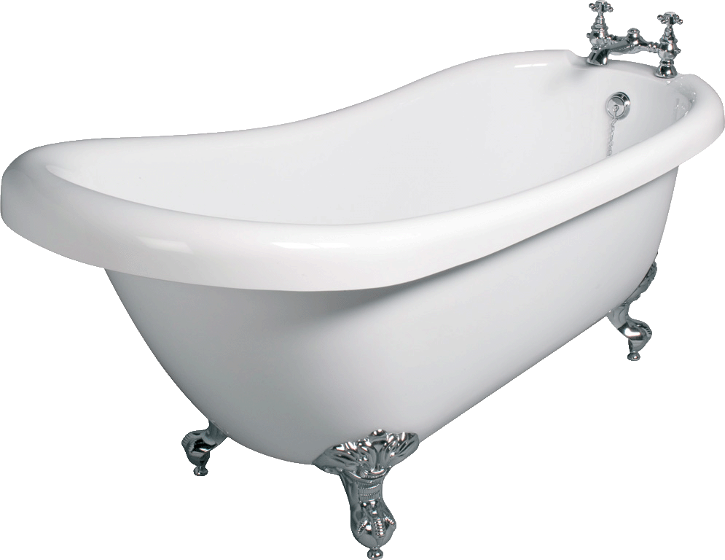
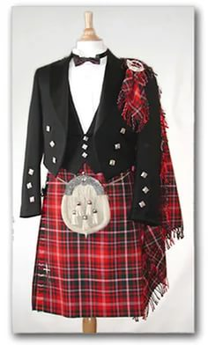

There’s no English national dress
The most famous traditional British dress is undoubtedly the Scottish kilt. The particular pattern of tartan represents the family clan that the person is from. Many people think that Scottish men wear kilts every day. That is not true!
The Scots, the Welsh and the Irish are very proud of their national songs. When the English play football against Scotland or Wales the Scots sing Flower of Scotland and the Welsh sing Land of My Fathers. But the English national song is the same as the British national song – God Save the Queen.
Having a bath, not a shower
No single mixture tap –
one for washing, the other for drinking from
(Нет единого водопроводного крана, один для мытья посуды, другой для питьевой воды)
The true Brit has a weekly bath
(принимает ванну раз в неделю)

Slide 10
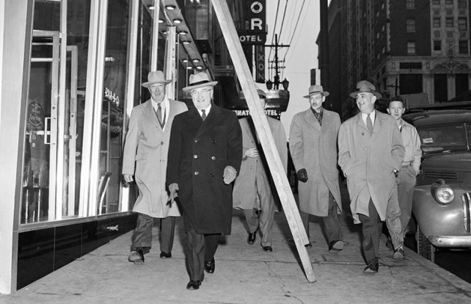
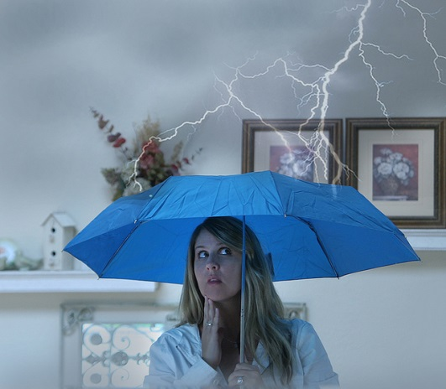
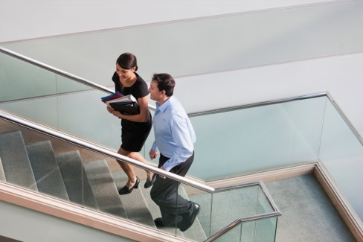
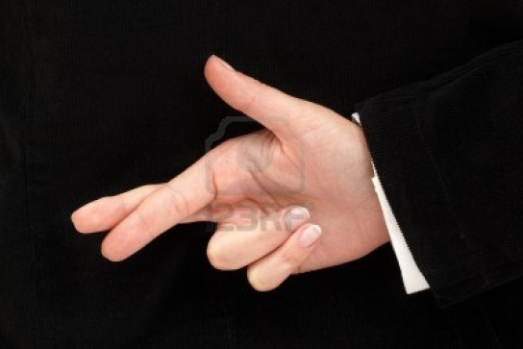
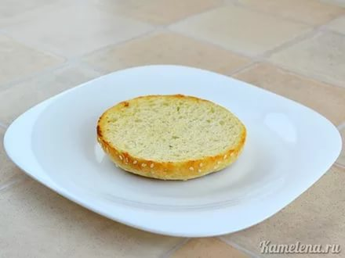
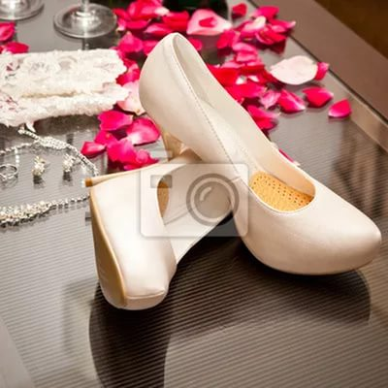
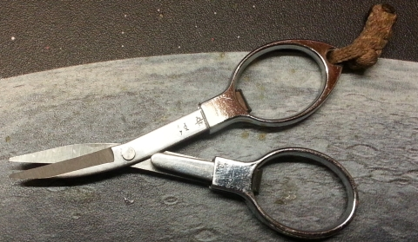
British superstitions
(Плохие приметы)
It's extremely unlucky to walk under a ladder propped against a wall or a building.
It's very bad luck to open an umbrella in the house - it will either bring misfortune to the person who has opened it or to those who live in the house.
It's unlucky to meet or pass someone on the stairs. It's unavoidable, cross your fingers.
It's unlucky to take the last piece of bread on the plate.
It's unlucky to put new shoes on the table.
It's bad luck to pick up scissors that you've dropped.

Slide 11
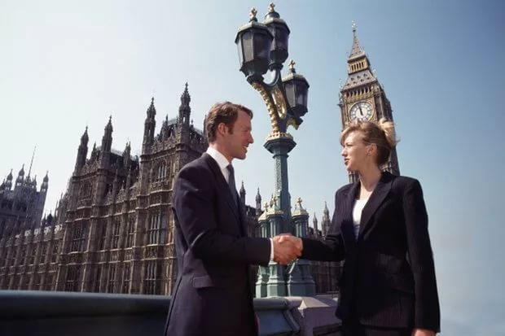
The British in quotes
An Englishman, even if he is alone, forms an orderly queue of one.
In Britain you need four ‘thank yous’ to buy a bus ticket.
queue jumping – получить что-то или пройти куда-то без очереди
sorry – одно из важнейших слов, которое всегда «на языке»
The true Brit can keep his head in a crisis! – не терять головы, сохранять спокойствие
He didn’t bat an eyelid! – Даже бровью не повёл! Даже глазом не моргнул!
He stands on his own two feet and earns his living by the sweat of his brow! – Он не нуждается ни в чьей помощи и зарабатывает на жизнь тяжелым трудом!
Although sometimes he would like to leg it and live in a lap of luxury, he knows it’s best to toe the line, knuckle down and work hard! – Хотя иногда ему хотелось бы отмахнуться от этого и жить в роскоши, он знает, что всегда приятнее придерживаться правил, решительно приняться за работу и стараться изо всех сил!

Slide 12
Выводы:
1. Мы не только ближе познакомились с британской культурой, но и составили собственную классификацию реалий английского языка на основе найденных и переведенных нами культурных реалий.
2. Благодаря проведенному анкетированию выяснили сферы жизни британцев, которыми старшеклассники интересуются больше всего.
3. Выделили наиболее встречающиеся и употребляемые в устной и письменной речи реалии и разработали брошюру «Facts about Britain» для старшеклассников.

